Slide 1
Computer Vision and Deep Learning
Lecture 7

Slide 2
Sequence models

Slide 3
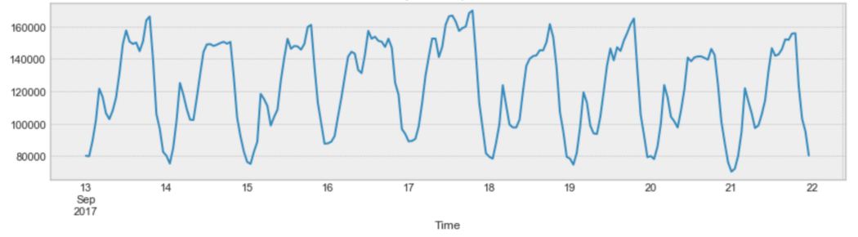
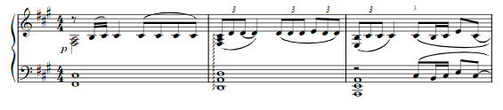
Sequence models
Numerical: time series (1d), nd
Categorical: characters, words, music keys etc.
T,h,e,r,e, ,w,a,s, ,a
There, was, a,

Slide 4
Sequence models
Sequence models are applied on sequences of different lengths using the same (shared weights)
Input sequence
Output: label (classification), number (regression), token, sequence

Slide 5
Sequence to sequence layers
Input: sequence of vectors
Output: sequence of vectors
Sequence to sequence layers can be applied on input sequences of different lengths (but using the same weights).
Sequence to sequence layers:
Recurrent neural networks
Convolutions
Self attention layers

Slide 6
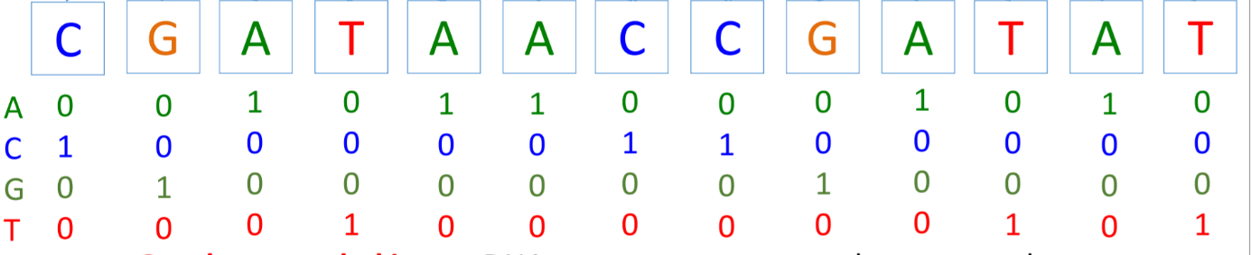
Processing discrete inputs
One hot encoding

Slide 7
Processing discrete inputs
Combined in some learning tasks and learned by backpropagation
Embedding: given a set of discrete values x_{i} ∈ X, model them by an embedding vector emb[x_{i}], such that if x_{i} and x_{j} are similar, so are emb[x_{i}] and emb[x_{j}]

Slide 8
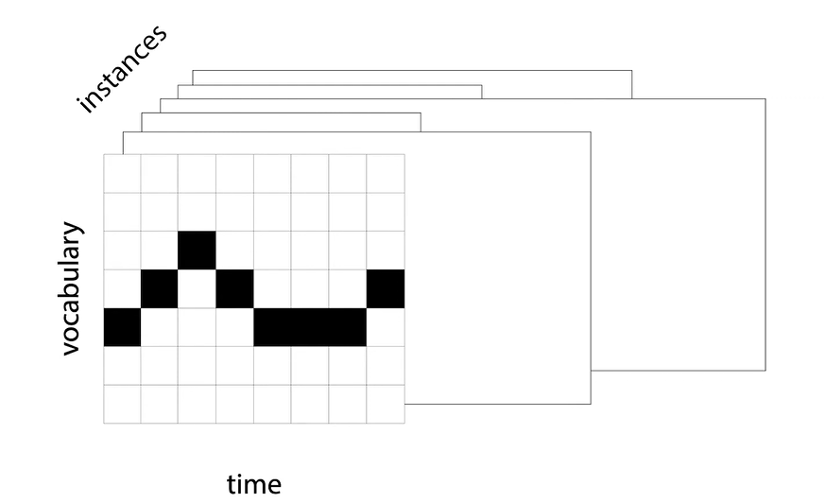
Batching sequences
Padding

Slide 9
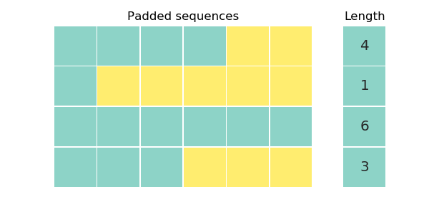
Batching sequences: padding
- You can use lengthwise sorting and use a dynamic batch size

Slide 10
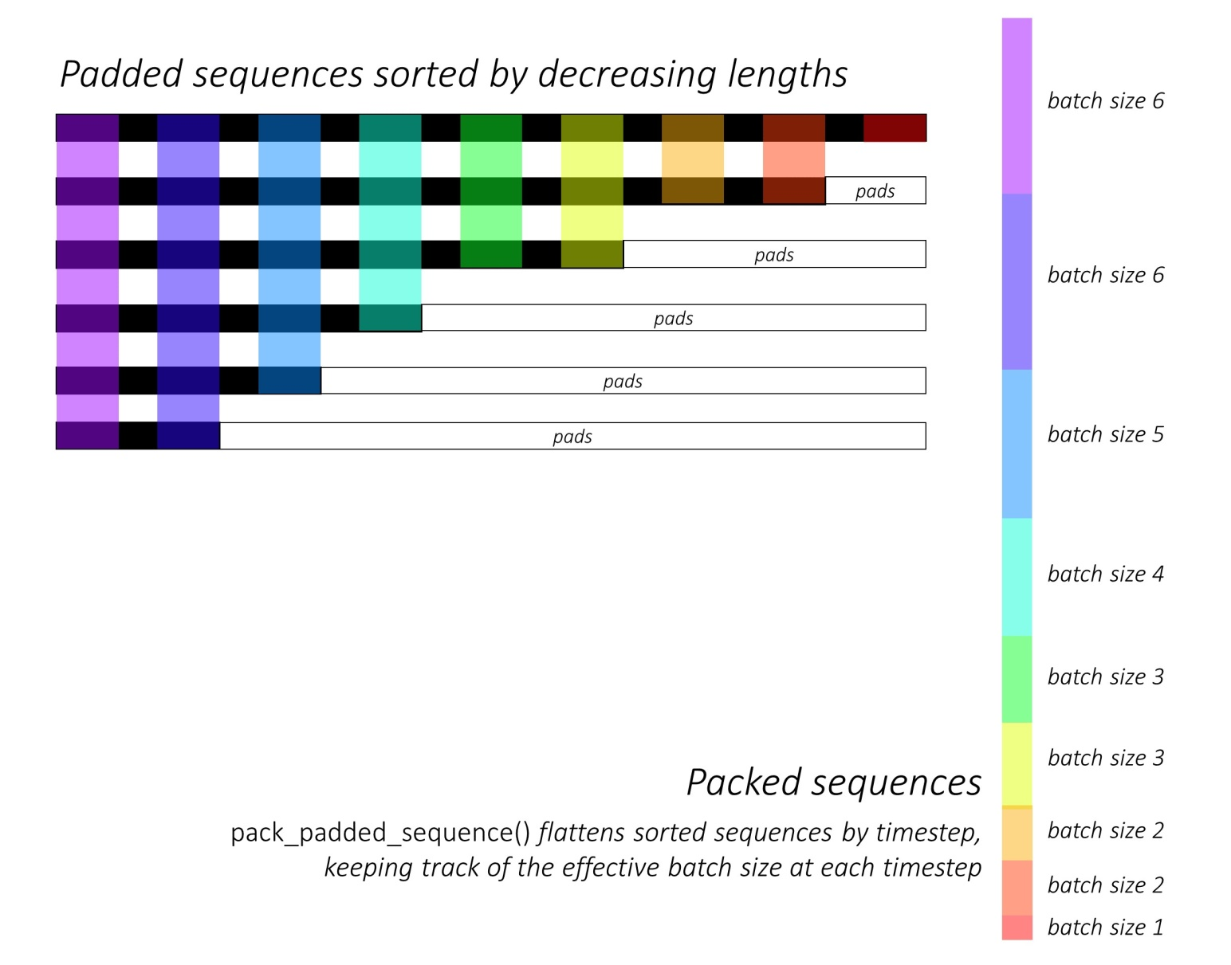
Batching sequences: packing

Slide 11
Definitions
Casuality: the way the elements in a layer are wired up
Casual layer: element xi has access only to elements x0, x1, …, xi-1

Slide 12
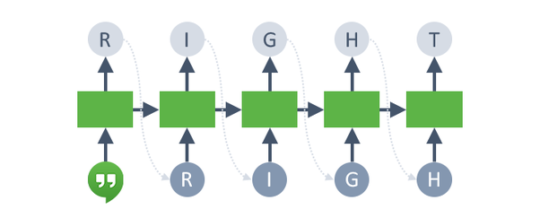
Definitions
Autoregressive model
Start with a seed (a few samples): [t0, t1]
Sample the next token t = 2 from P(t | t0, t1) and append it to the sequence
Feed the sequence to the network
REPEAT

Slide 13
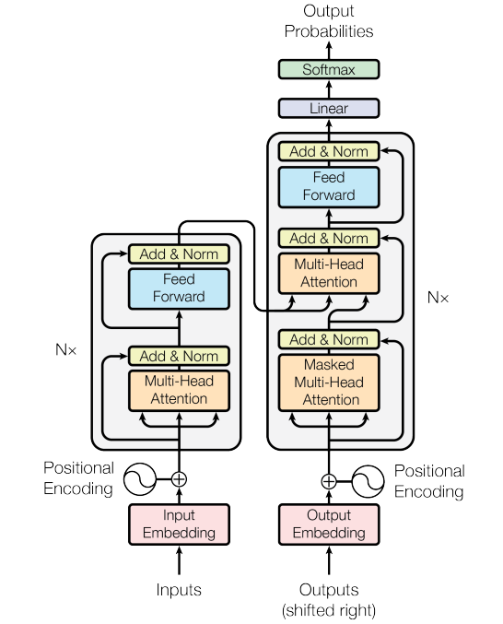
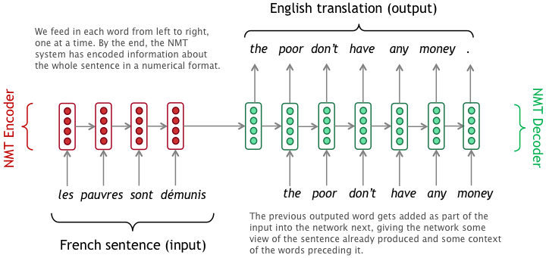
Definitions
Teacher forcing
https://medium.com/@vivekvscool/translation-or-answer-tool-seq2seq-with-teacher-forcing-and-attention-mechanism-7cfd9cb03b3a

Slide 14
Patterns in sequence models

Slide 15
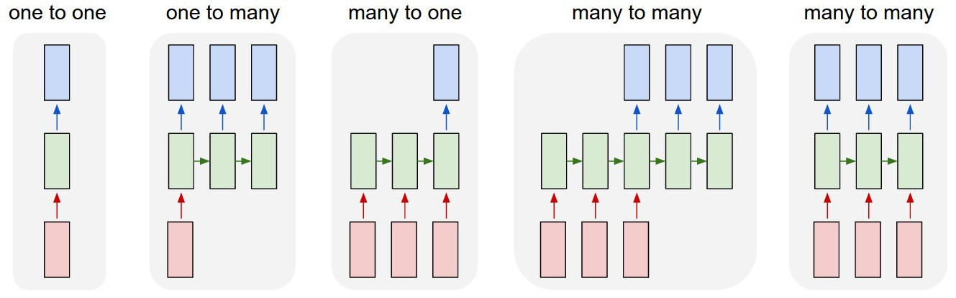
Process sequences

Slide 16
Process sequences
Image captioning,
Text generation

Slide 17
Process sequences
Action recognition
Sentiment classification

Slide 18
Process sequences
Text translation
Video classification at frame level

Slide 19
Recurrent neural networks

Slide 20
Recurrent neural networks
A recurrent neural network is a network where we can have a cycle between two nodes
y^{<t>}
RNN cell h^{<t>}
x^{<t>}

Slide 21
RNN cell
Recurrent core cell
Input: x^{<t>}
Internal hidden state: h^{<t>}
updated each time an input x^{<t>} is fed to the cell
Output: y^{<t>}
at some time steps
y^{<t>}
RNN cell h^{<t>}
x^{<t>}

Slide 22
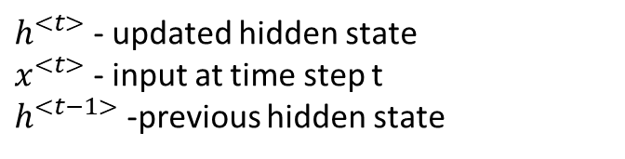

RNN cell
$$h^{<t>} =f_{W}(h^{<t−1>},x^{<t>})$$
$h^{<t>}$ - updated hidden state
$x^{<t>}$ - input at time step t
$h^{<t−1>}$ -previous hidden state
y^{<t>}
RNN cell
x^{<t>}

Slide 23

RNN cell
$$h^{<t>} =f_{W}(h^{<t−1>},x^{<t>})$$
$h^{<t>}$ - updated hidden state
$x^{<t>}$ - input at time step t
$h^{<t−1>}$ -previous hidden state
y^{<t>}
RNN cell
$$h^{<t>}=tanh⁡(W_{h}h^{<t−1>}+W_{x}x^{<t>})$$
x^{<t>}
nonlinearity

Slide 24

RNN cell
$$h^{<t>} =f_{W}(h^{<t−1>},x^{<t>})$$
$h^{<t>}$ - updated hidden state
$x^{<t>}$ - input at time step t
$h^{<t−1>}$ -previous hidden state
y^{<t>}
RNN cell
$$h^{<t>}=tanh⁡(W_{h}h^{<t−1>}+W_{x}x^{<t>})$$
x^{<t>}
$y^{<t>}$ : make a decision based on $h^{<t>}$ each time step
$$y^{<t>}=W_{y}h^{<t>}$$

Slide 25


RNN cell
y^{<1>}
$$y^{<1>}=W_{y}h^{<1>}$$
RNN cell
h^{<1>}
$$h^{<1>}=tanh⁡(W_{h}h^{<0>}+W_{x}x^{<1>})$$
h^{<0>} = [0, .., 0]
x^{<1>}
x^{<2>}
x^{<3>}

Slide 26


RNN cell
y^{<1>}
y^{<2>}
RNN cell
$$y^{<2>}=W_{y}h^{<2>}$$
h^{<2>}
$$h^{<2>}=tanh⁡(W_{h}h^{<1>}+W_{x}x^{<2>})$$
h^{<1>}
x^{<1>}
x^{<2>}
x^{<3>}
x^{<4>}

Slide 27


RNN cell
y^{<1>}
y^{<2>}
y^{<3>}
RNN cell
$$y^{<3>}=W_{y}h^{<3>}$$
h^{<3>}
$$h^{<3>}=tanh⁡(W_{h}h^{<2>}+W_{x}x^{<3>})$$
h^{<2>}
x^{<1>}
x^{<2>}
x^{<3>}
x^{<4>}
x^{<5>}

Slide 28
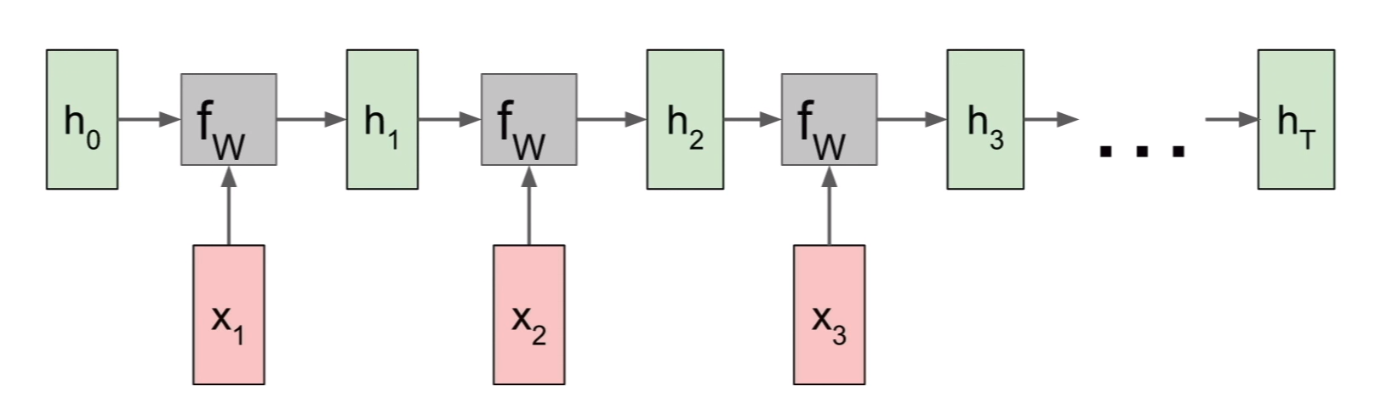
RNN computational graph
Initialized to 0 in most contexts
https://calvinfeng.gitbook.io/machine-learning-notebook/supervised-learning/recurrent-neural-network/recurrent_neural_networks

Slide 29
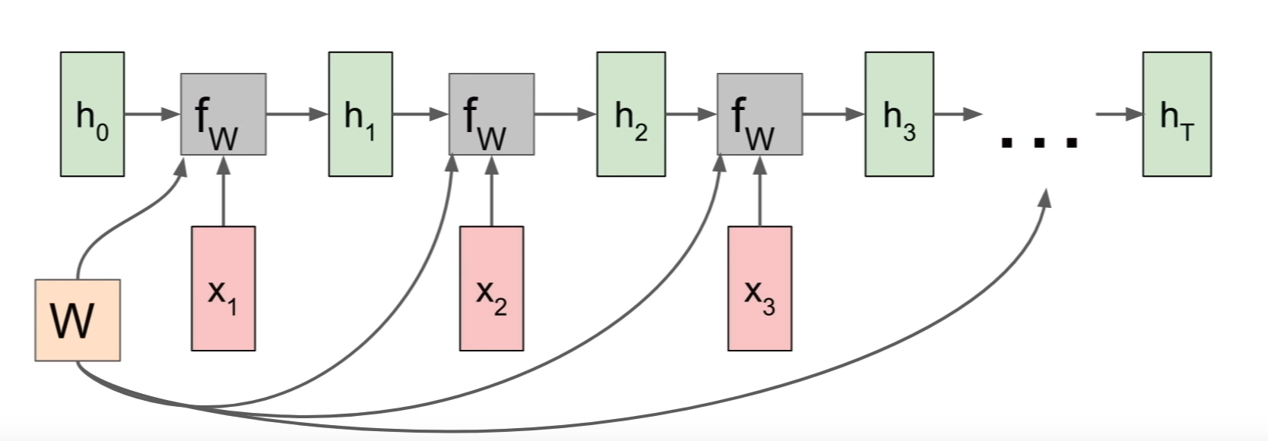
RNN computational graph
Shared weight matrix (we use the same set of weight for every time step of the computation).
Backprop
Separate gradient for each W (from each of the timestamps)
Total gradient: sum of the timestamp gradients
https://calvinfeng.gitbook.io/machine-learning-notebook/supervised-learning/recurrent-neural-network/recurrent_neural_networks

Slide 30
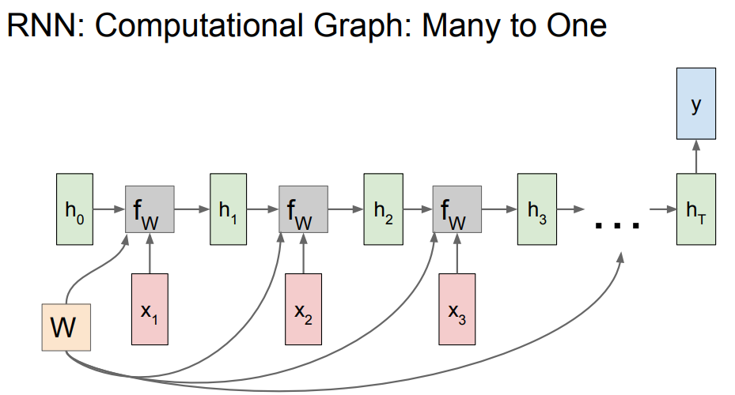
RNN computational graph Many to one
https://calvinfeng.gitbook.io/machine-learning-notebook/supervised-learning/recurrent-neural-network/recurrent_neural_networks

Slide 31
RNN computational graph Many to one
Make decision on the last hidden state
(it summarizes the entire sequence)
https://calvinfeng.gitbook.io/machine-learning-notebook/supervised-learning/recurrent-neural-network/recurrent_neural_networks

Slide 32
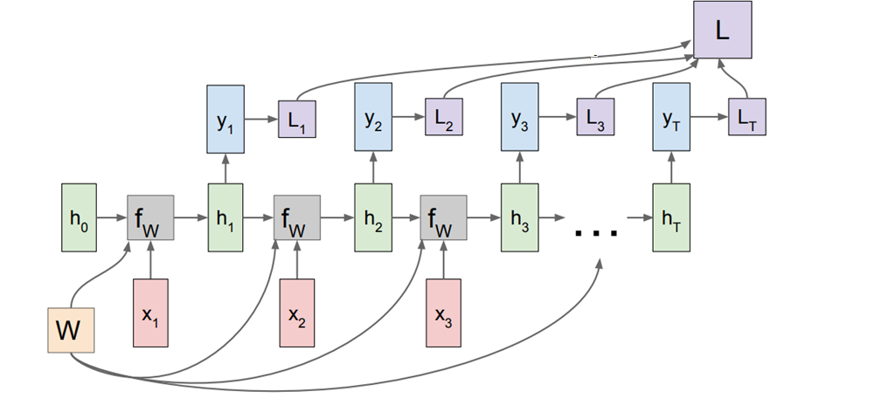
RNN computational graph Many to many
Compute loss at each timestamp
https://calvinfeng.gitbook.io/machine-learning-notebook/supervised-learning/recurrent-neural-network/recurrent_neural_networks

Slide 33
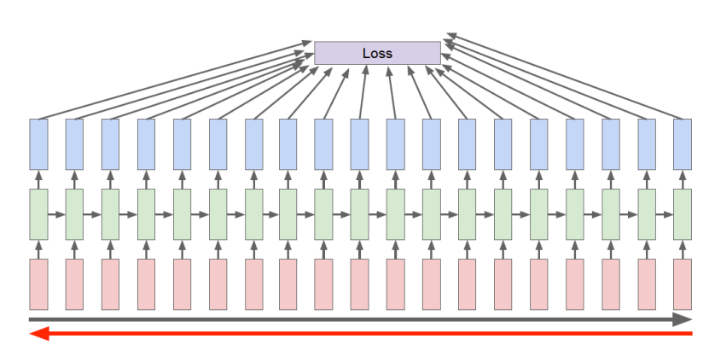
Backpropagation through time
Forward through entire sequence to compute loss, then backward through entire sequence to compute gradient.

Slide 34
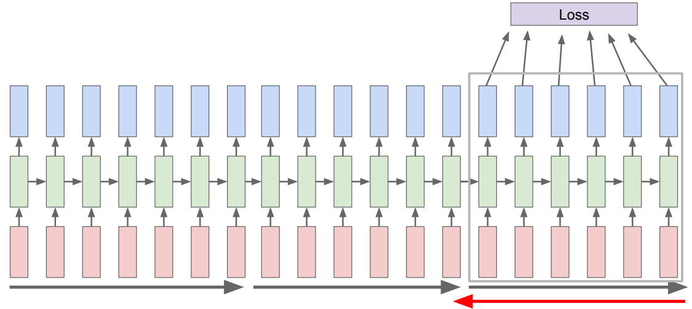
Truncated back-propagration through time
Run forward and backward through chunks of the sequence instead of whole sequence

Slide 35
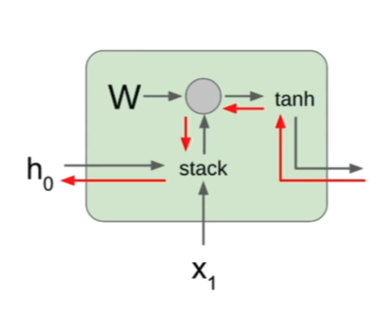
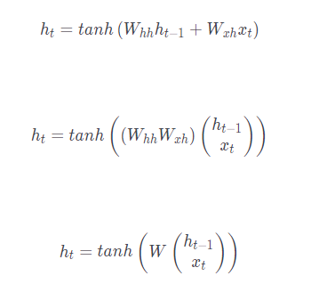
RNN backward pass
During backpropagation from the next state to the current state we pass through a matrix multiplication step

Slide 36
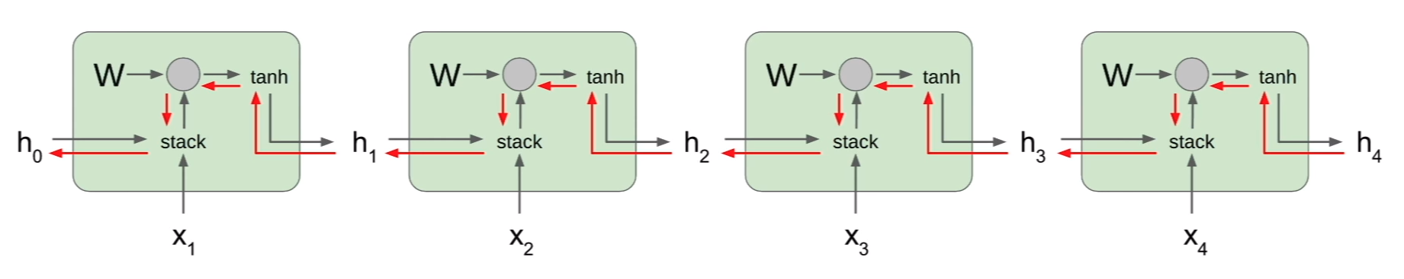
RNN backward pass
At each cell we multiply by many factors of the weight matrix W
> 1: exploding gradients (gradient clipping): scale the value of the gradient if it is too big
< 1: vanishing gradients

Slide 37
Long short term memory
https://colah.github.io/posts/2015-08-Understanding-LSTMs/

Slide 38
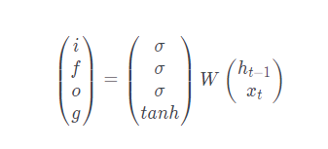


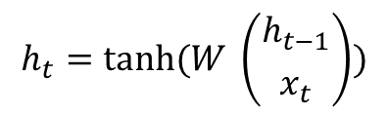
Long short term memory, 1997
Alleviate the problems of vanishing and exploding gradient
Selective forgetting and remembering (gates)
RNN
LSTM
$$h_{t}=tanh⁡(W \left({h_{t−1} \atop x_{t}}\right))$$
Two hidden states:
c – cell state
h – hidden state

Slide 39

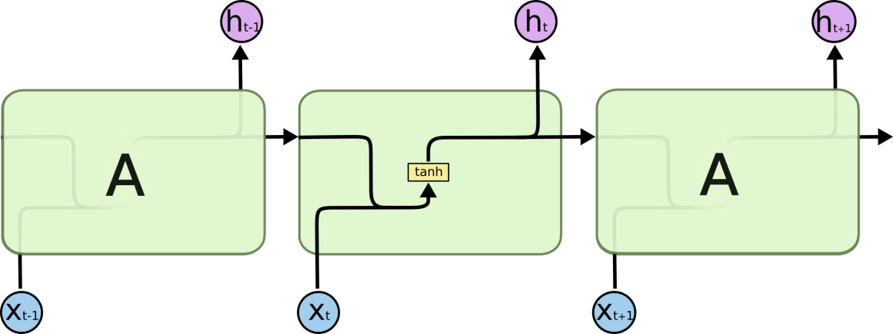
Long short term memory, 1997
Alleviate the problems of vanishing and exploding gradient
RNN LSTM
Two hidden states:
c – cell state
h – hidden state

Slide 40
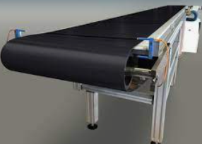
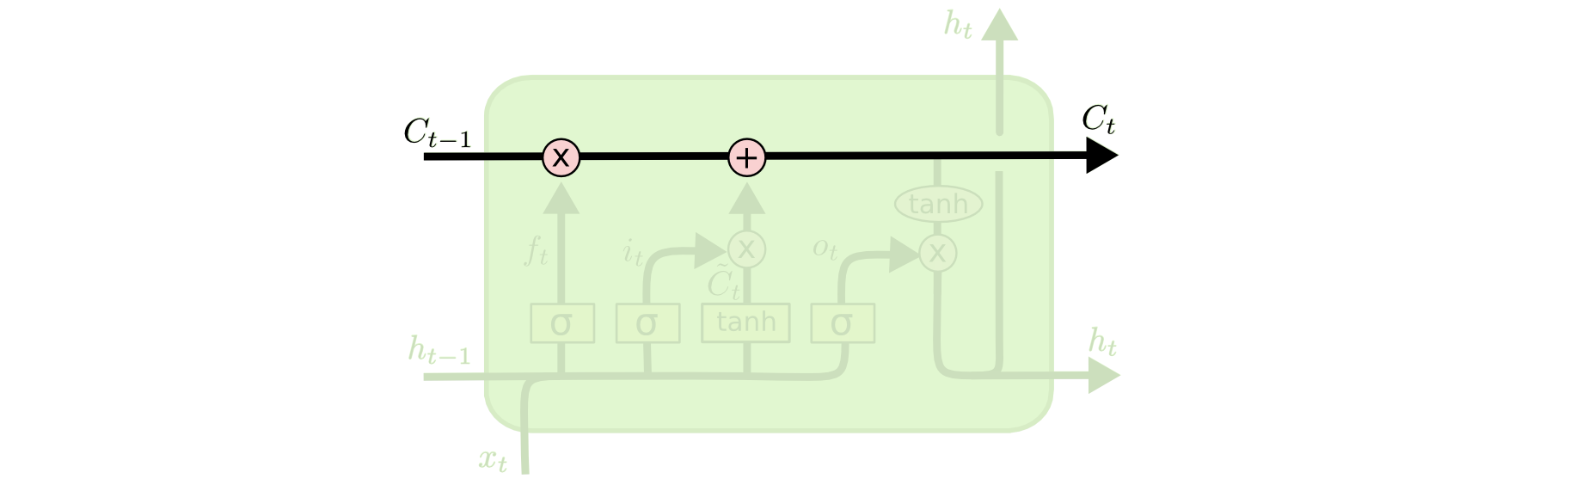
Long short term memory
Conveyor belt: previous cell state passes to become the next cell state with only some minor linear interactions

Slide 41
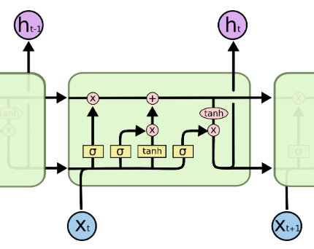
Long short term memory
Concatenate previous hidden state cell with the current input and multiply them with a bigger weight matrix to compute four gates

Slide 42
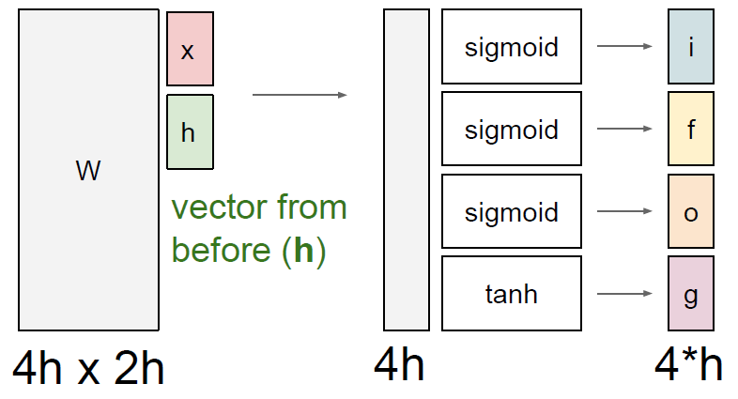
LSTM cell

Slide 43
Long short term memory
forget gate: whether to erase cell (how much we want to forget from the previous cell state?)
input gate: whether to write to cell (how much to input into our cell?)
g gate: how much to write to cell (how much to write into our cell?)
output gate: how much to reveal cell (how much to reveal from ourselves to the outside?

Slide 44
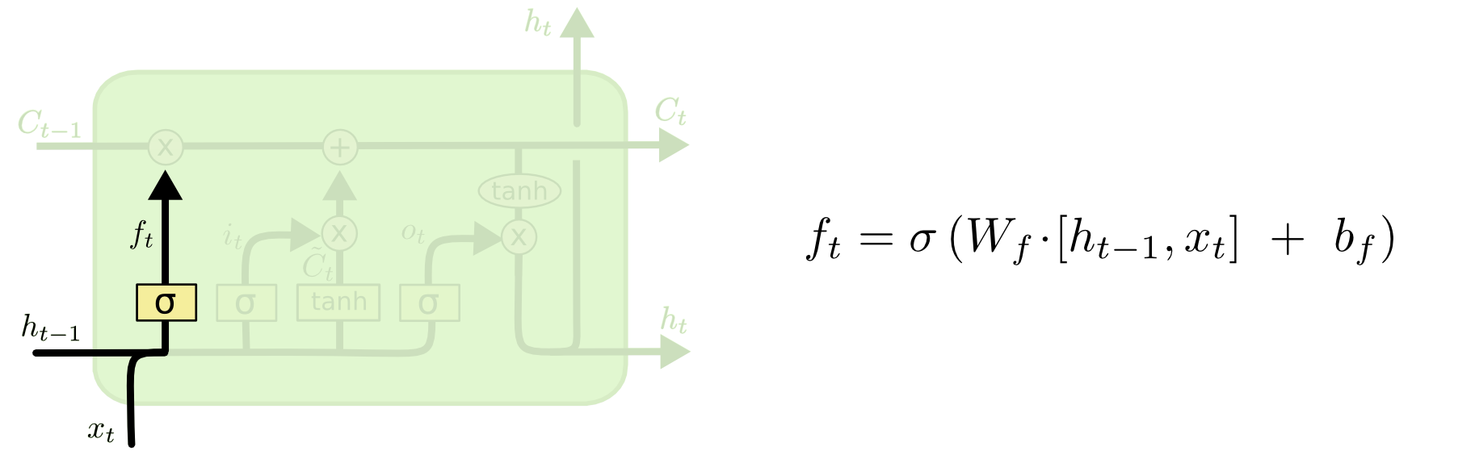
Long short term memory Forget gate: how much we want to forget from the previous cell state?/ whether to erase the cell
Sigmoid: [0, 1]
tanh: [-1, 1]
Element wise multiplication: forget that element of the cell (0), or remember it (1)

Slide 45
Long short term memory Forget gate: how much we want to forget from the previous cell state?/ whether to erase the cell
Intuition: “The cell state might include the gender of the present subject, so that the correct pronouns can be used. When we see a new subject, we want to forget the gender of the old subject.”
https://colah.github.io/posts/2015-08-Understanding-LSTMs/

Slide 46
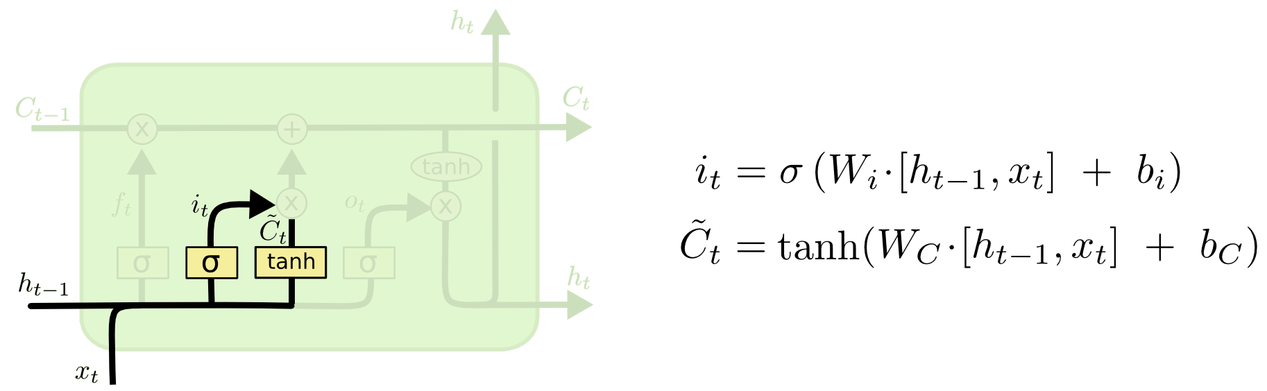
Long short term memory Input gate: how much to input into our cell? / whether to write to cell
Sigmoid: [0, 1]
tanh: [-1, 1]
Element wise multiplication: for each element of the cell state, do we want to write to (1) it or not (0)?

Slide 47
Long short term memory Input gate: how much to input into our cell? / whether to write to cell g gate: how much to write to cell (how much to write into our cell?)
Sigmoid: [0, 1]
tanh: [-1, 1]
Element wise multiplication: the candidate value that we might consider writing to the current cell state [-1, 1] (creates a vector of new candidate values, that could be added to the state)

Slide 48
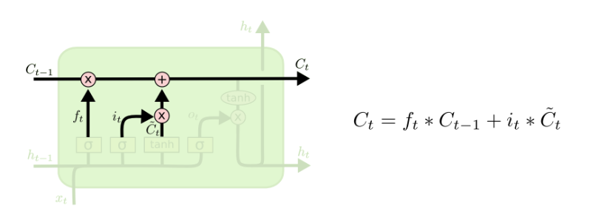
Long short term memory Input gate: how much to input into our cell? / whether to write to cell g gate: how much to write to cell (how much to write into our cell?)
Intuition: “We’d want to add the gender of the new subject to the cell state, to replace the old one we’re forgetting.”
Illustration of where drop the information about the old subject’s gender and add the new information
https://colah.github.io/posts/2015-08-Understanding-LSTMs/

Slide 49
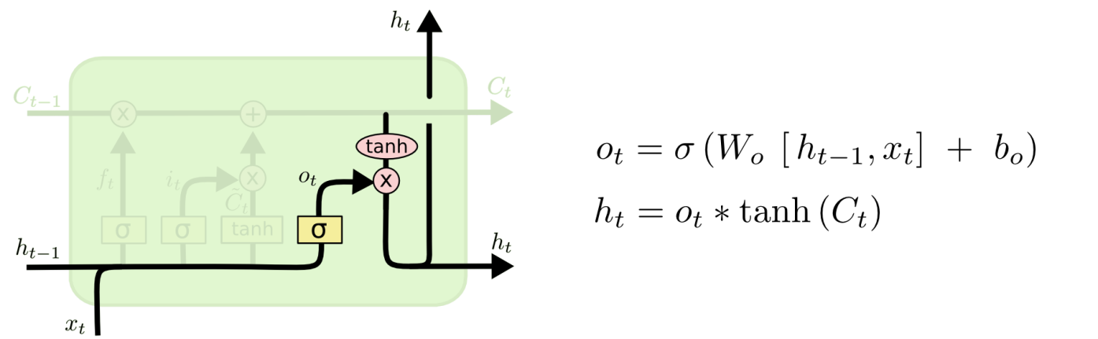
Long short term memory output gate: how much to reveal cell (how much to reveal from ourselves to the outside?
The output will be based on the cell state, but will be a filtered version.
Sigmoid: [0, 1]
tanh: [-1, 1]
Use the cell state to compute a hidden state which we will reveal to the outside world
Sigmoid: for each element of out cell state, do we want to reveal it or not?

Slide 50
Long short term memory output gate: how much to reveal cell (how much to reveal from ourselves to the outside?
Intuition: “For the language model example, since it just saw a subject, it might want to output information relevant to a verb, in case that’s what is coming next. For example, it might output whether the subject is singular or plural, so that we know what form a verb should be conjugated into if that’s what follows next”
https://colah.github.io/posts/2015-08-Understanding-LSTMs/

Slide 51
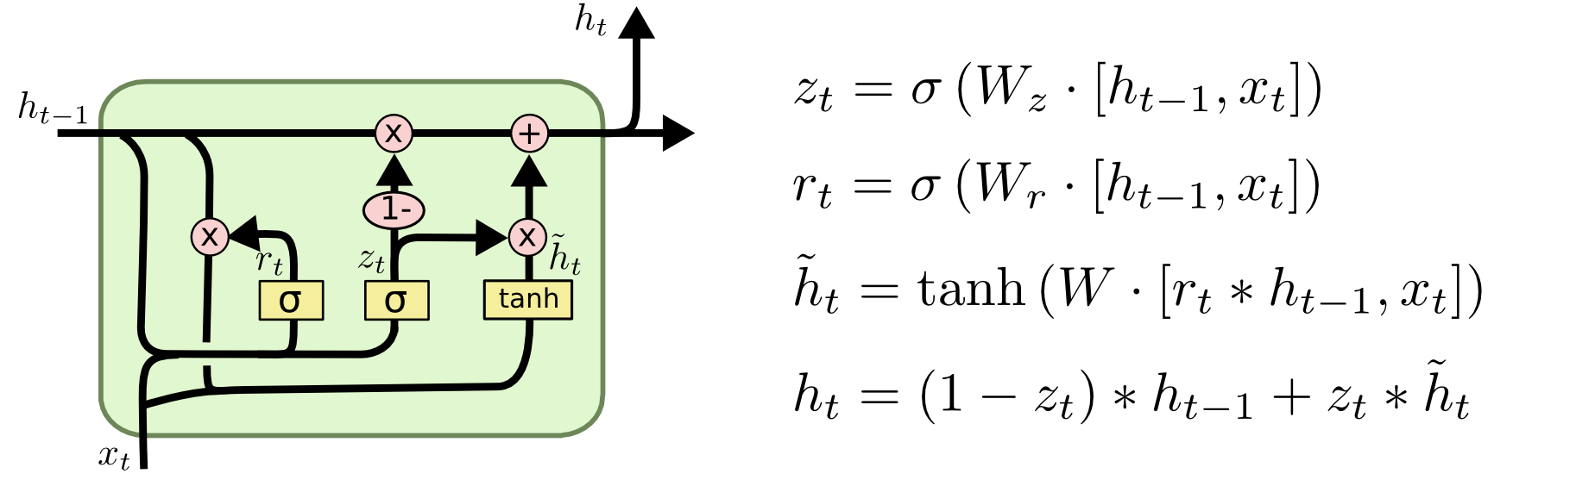
Lots of variations of LSTMs were proposed
Gated Recurrent Unit (GRU) – simplify the architecture of the LSTM

Slide 52
The Unreasonable Effectiveness of Recurrent Neural Networks
https://karpathy.github.io/2015/05/21/rnn-effectiveness/
Shakespeare
PANDARUS:
Alas, I think he shall be come approached and the day When little srain would be attain'd into being never fed, And who is but a chain and subjects of his death, I should not sleep.
Second Senator:
They are away this miseries, produced upon my soul, Breaking and strongly should be buried, when I perish The earth and thoughts of many states.
DUKE VINCENTIO:
Well, your wit is in the care of side and that. Second Lord: They would be ruled after this chamber, and my fair nues begun out of the fact, to be conveyed, Whose noble souls I'll have the heart of the wars.
Clown: Come, sir, I will make did behold your worship.
VIOLA: I'll drink it.

Slide 53
The Unreasonable Effectiveness of Recurrent Neural Networks
https://karpathy.github.io/2015/05/21/rnn-effectiveness/
Wikipedia
Naturalism and decision for the majority of Arab countries' capitalide was grounded by the Irish language by [[John Clair]], [[An Imperial Japanese Revolt]], associated with Guangzham's sovereignty. His generals were the powerful ruler of the Portugal in the [[Protestant Immineners]], which could be said to be directly in Cantonese Communication, which followed a ceremony and set inspired prison, training. The emperor travelled back to [[Antioch, Perth, October 25|21]] to note, the Kingdom of Costa Rica, unsuccessful fashioned the [[Thrales]], [[Cynth's Dajoard]], known in western [[Scotland]], near Italy to the conquest of India with the conflict. Copyright was the succession of independence in the slop of Syrian influence that was a famous German movement based on a more popular servicious, non-doctrinal and sexual power post. Many governments recognize the military housing of the [[Civil Liberalization and Infantry Resolution 265 National Party in Hungary]], that is sympathetic to be to the [[Punjab Resolution]] (PJS)[http://www.humah.yahoo.com/guardian. cfm/7754800786d17551963s89.htm Official economics Adjoint for the Nazism, Montgomery was swear to advance to the resources for those Socialism's rule, was starting to signing a major tripad of aid exile.]]

Slide 54
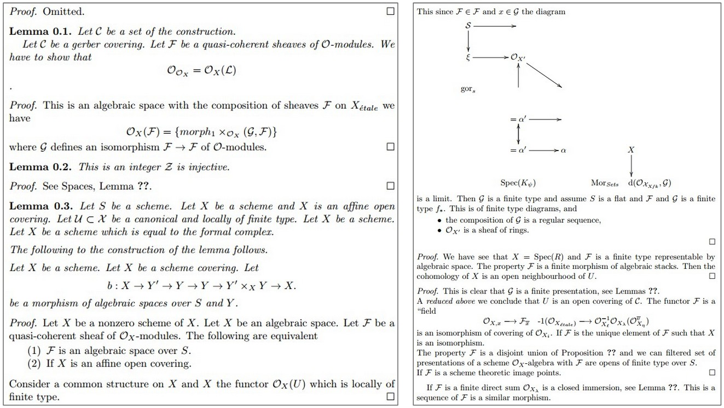
The Unreasonable Effectiveness of Recurrent Neural Networks

